Slide 1
INVESTMENT CASE STUDY

Slide 2
Abstract
Spark Funds, an asset management company, wants to make investments in a few companies
Spark Funds has two minor constraints for investments:
It wants to invest between 5 to 15 million USD per round of investment
It wants to invest only in English-speaking countries because of the ease of communication with the companies it would invest in.
We do an analysis on real investment data and our goal is to find the best Investment type, the countries most heavily invested in and the best sector to invest in.
The overall strategy is to invest where others are investing, implying that the 'best' sectors and countries are the ones 'where most investors are investing'.

Slide 3
Problem solving methodology
Import data -> Inspect data for encoding issues -> clean the data of null values -> calculate average amount for the funding types ->select the funding type best suited for Sparks. -> Find the top 3 english speaking countries that received the most investments->extract the primary sector ->map each primary sector to its main sector( work with the mapping file ->reshape the dataframe)->find the best sector for investment for sparks.

Slide 4
Analysis
Funding Type Analysis
From the analysis we find the below average funding:
Seed=0.72 Million USD
Angel=0.96 Million USD
Venture= 11.72 Million USD
Private equity = 73.39 Million USD
Sparks Funds wants to invest between 5 to 15 million USD per round of investment.
Therefore the best Fund type would be Venture.

Slide 5
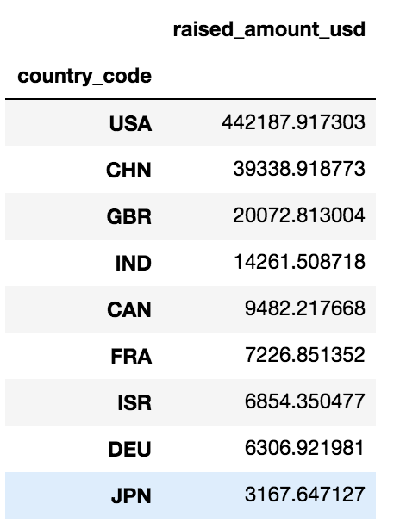
Analysis
Country Analysis
Spark Funds wants to invest in countries with the highest amount of funding for the chosen investment type. This is a part of its broader strategy to invest where most investments are occurring.
Therefore we find the top 9 countries which received the highest amount of funding.
Then we recommend the top 3 English speaking countries to invest in.
The top 3 English speaking countries are:
Unites States
United Kingdom
India

Slide 6
Analysis
Sector Analysis
We further do our analysis keeping in mind that investment should be between 5 -15 million USD and funding type is venture.
Then we do a sector analysis for the top 3 countries we suggested.
The primary sector has been identified from data and has been mapped to its corresponding main sector.
The 3 best main sectors identified for the top 3 countries are as below:
United States | United Kingdom | India
Others | Others | Others
Social, Finance, Analytics, Advertising | Social, Finance, Analytics, Advertising | Social, Finance, Analytics, Advertising
Cleantech / Semiconductors | Cleantech / Semiconductors | News, Search and Messaging

Slide 7
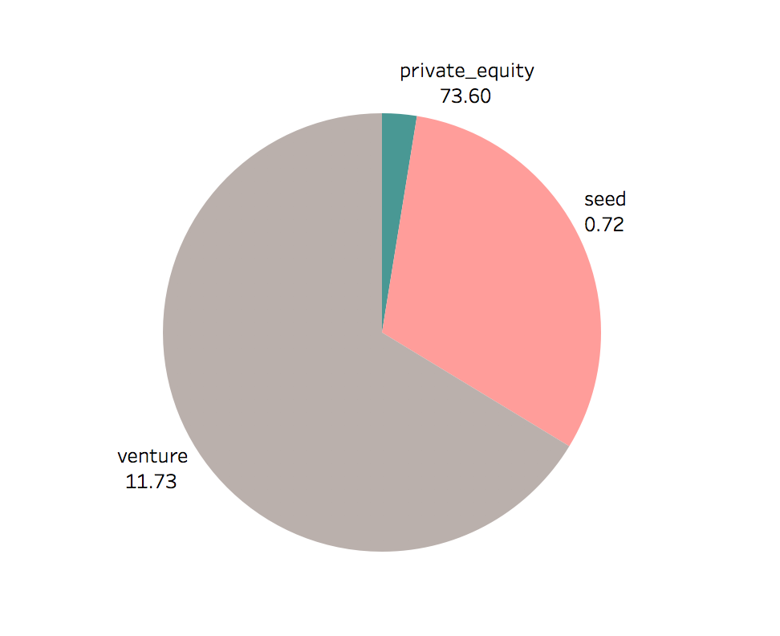
Results
Plot 1
A plot showing the fraction of total investments (globally) in venture, seed, and private equity, and the average amount of investment in each funding type. Funding type venture.

Slide 8
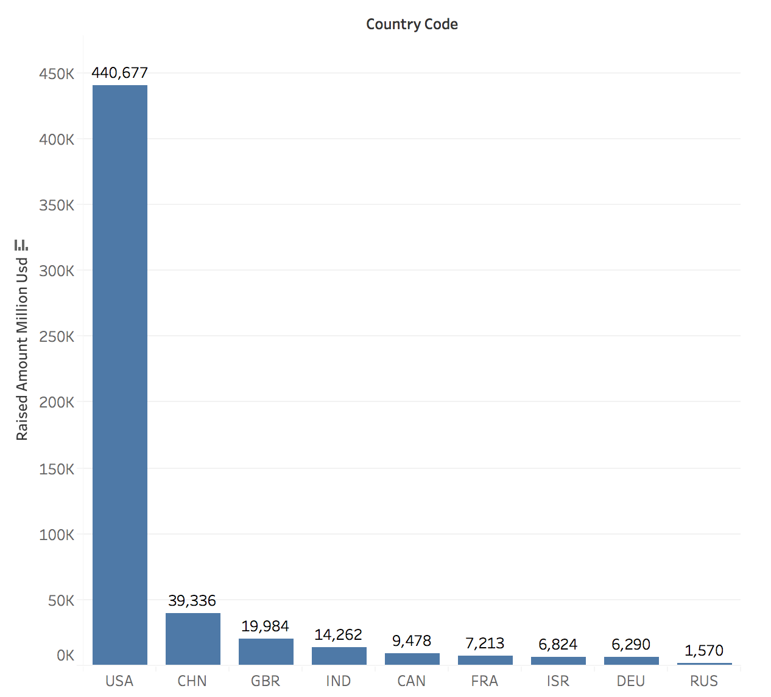
Results
Plot 2
A plot showing the top 9 countries against the total amount of investments of funding type venture.
The top 3 English speaking countries would be
USA, GBR, IND

Slide 9
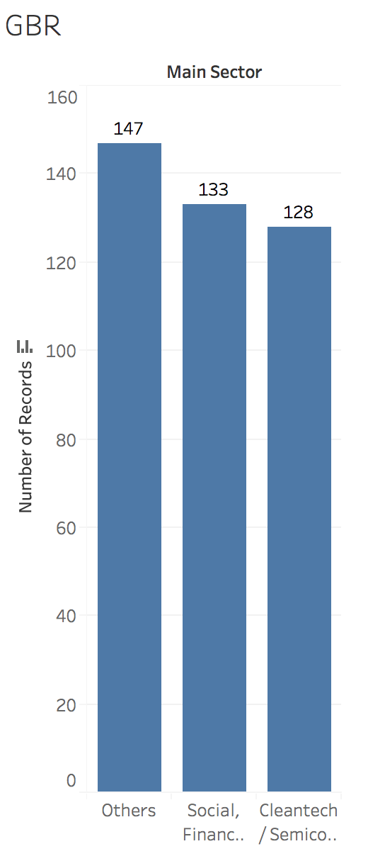
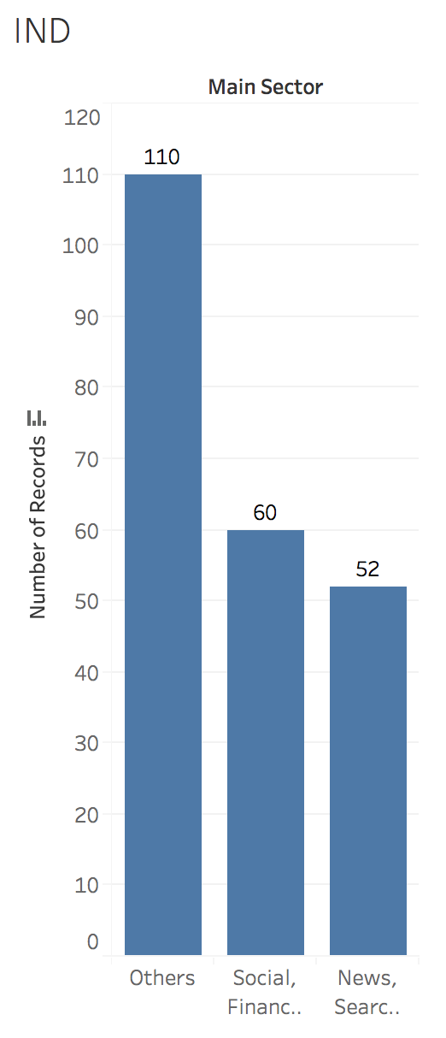
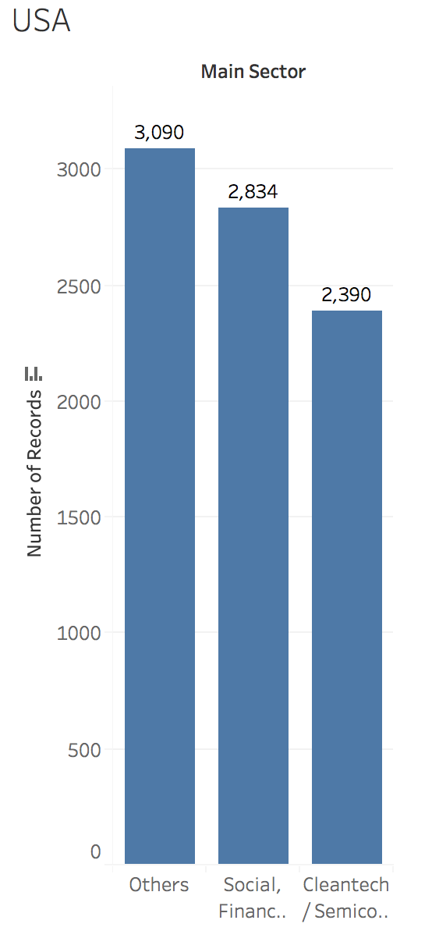
Results
Plot 3
A plot showing the number of investments in the top 3 sectors of the top 3 countries on one chart.

Slide 10
Conclusions
Therefore from our analysis and keeping in mind the business requirements for Sparks Fund,
We recommend to invest in funding type Venture.
Invest in countries USA, GBR,IND
And the best sector to invest is Others, Social, Finance, Analytics, Advertising, News, Search and Messaging.

